Slide 1
MaTPLotLiB

Slide 2
Data Visualization
Very Important in Data Analysis
Explore Data
Report Insights

Slide 3
Matplotlib Introduction
"grandfather" library of data visualization with Python.
Created by John Hunter.
replicate MatLab's (another programming language) plotting capabilities in Python.
Matplotlib allows you to create reproducible figures programmatically
Explore the official Matplotlib web page: http://matplotlib.org/

Slide 4
Introduction
Some of the major Pros of Matplotlib are:
It is an excellent 2D and 3D graphics library for generating scientific figures.
Generally easy to get started for simple plots
Support for custom labels and texts
Great control of every element in a figure
High-quality output in many formats
Very customizable in general

Slide 5
Installation
You'll need to install matplotlib first with either:
conda install matplotlib
or
pip install matplotlib

Slide 6
Importing
Import the matplotlib.pyplot (sub-module/sub-package) module under the name plt (the tidy way):
import matplotlib.pyplot as plt
You'll also need to use this line to see plots in the notebook:
%matplotlib inline
That line is only for jupyter notebooks, if you are using another editor, you'll use: plt.show() at the end of all your plotting commands

Slide 7
Basic Example
import numpy as np
x = np.linspace(0, 5, 11) #create linear spaced values
y = x ** 2
We can create a very simple line plot using the following
plt.plot(x, y, 'r') # plots x and y data, 'r' is the color red
plt.xlabel('X Axis Title Here') # sets the x axis label
plt.ylabel('Y Axis Title Here') # sets the y axis label
plt.title('String Title Here') # sets the title of plot
plt.show() # Displays a plot

Slide 8
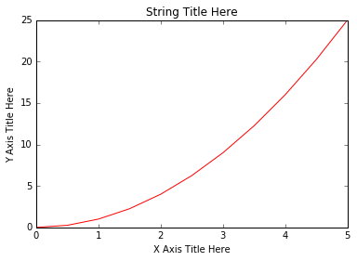
Basic Example

Slide 9
Creating Multiplots on Same Canvas
# plt.subplot(nrows, ncols, plot_number)
plt.subplot(1,2,1)
plt.plot(x, y, 'r--') # More on color options later
plt.subplot(1,2,2)
plt.plot(y, x, 'g*-');

Slide 10
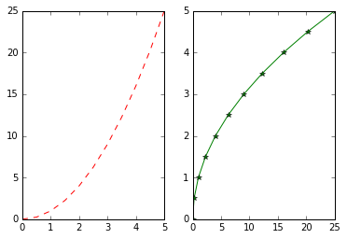
Creating Multiplots on Same Canvas

Slide 11
Matplotlib Object Oriented Method
create figure objects
then just call methods or attributes off of that object.
This approach is nicer when dealing with a canvas that has multiple plots on it.

Slide 12
Matplotlib Object Oriented Method
To begin we create a figure instance. Then we can add axes to that figure:
# Create Figure (empty canvas)
fig = plt.figure()
# Add set of axes to figure
axes = fig.add_axes([0.1, 0.1, 0.8, 0.8]) # left, bottom, width, height (range 0 to 1)
# Plot on that set of axes
axes.plot(x, y, 'b')
axes.set_xlabel('Set X Label') # Notice the use of set_ to begin methods
axes.set_ylabel('Set y Label')
axes.set_title('Set Title')

Slide 13
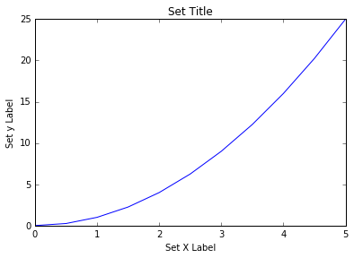
Matplotlib Object Oriented Method

Slide 14
More Complex with two figures
# Creates blank canvas
fig = plt.figure()
axes1 = fig.add_axes([0.1, 0.1, 0.8, 0.8]) # main axes
axes2 = fig.add_axes([0.2, 0.5, 0.4, 0.3]) # inset axes
# Larger Figure Axes 1
axes1.plot(x, y, 'b')
axes1.set_xlabel('X_label_axes2')
axes1.set_ylabel('Y_label_axes2')
axes1.set_title('Axes 2 Title')
# Insert Figure Axes 2
axes2.plot(y, x, 'r')
axes2.set_xlabel('X_label_axes2')
axes2.set_ylabel('Y_label_axes2')
axes2.set_title('Axes 2 Title');
Note:we now have full control of where the plot axes are placed

Slide 15
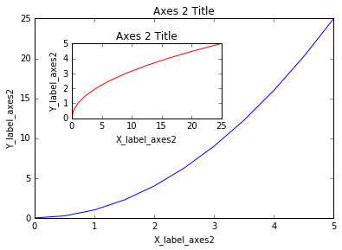
More Complex with two figures

Slide 16
subplots()
The plt.subplots() object will act as a more automatic axis manager.
# Use similar to plt.figure() except use tuple unpacking to grab fig and axes
fig, axes = plt.subplots()
# Now use the axes object to add stuff to plot
axes.plot(x, y, 'r')
axes.set_xlabel('x')
axes.set_ylabel('y')
axes.set_title('title');

Slide 17
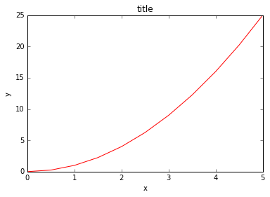
subplots()

Slide 18
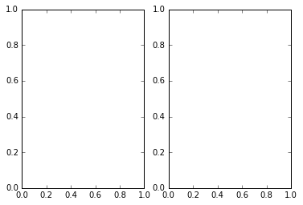
subplots()
# Empty canvas of 1 by 2 subplots
fig, axes = plt.subplots(nrows=1, ncols=2)

Slide 19
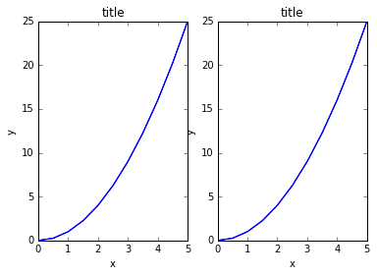
subplots()
for ax in axes:
ax.plot(x, y, 'b')
ax.set_xlabel('x')
ax.set_ylabel('y')
ax.set_title('title')
# Display the figure object
Fig
plt.tight_layout()
Note: A common issue with matplolib is overlapping subplots or figures. fig.tight_layout() or plt.tight_layout() method automatically adjusts the positions of the axes on the figure canvas so that there is no overlapping content:

Slide 20
Figure size, aspect ratio and DPI
Matplotlib allows the aspect ratio, DPI and figure size to be specified when the Figure object is created.
figsize is a tuple of the width and height of the figure in inches
dpi is the dots-per-inch (pixel per inch).
fig = plt.figure(figsize=(8,4), dpi=100)
or
fig, axes = plt.subplots(figsize=(12,3))

Slide 21
Saving figures
fig.savefig("filename.png")
or
fig.savefig("filename.png", dpi=200)

Slide 22
Legends, labels and titles
fig = plt.figure()
ax = fig.add_axes([0,0,1,1])
ax.plot(x, x**2, label="x**2")
ax.plot(x, x**3, label="x**3")
ax.set_title("title");
ax.set_xlabel("x")
ax.set_ylabel("y");
ax.legend()
# Most common to choose
ax.legend(loc=0) # let matplotlib decide the optimal location
fig
(loc=0) # Optimal Location
(loc=1) # upper right corner
(loc=2) # upper left corner
(loc=3) # lower left corner
(loc=4) # lower right corner

Slide 23
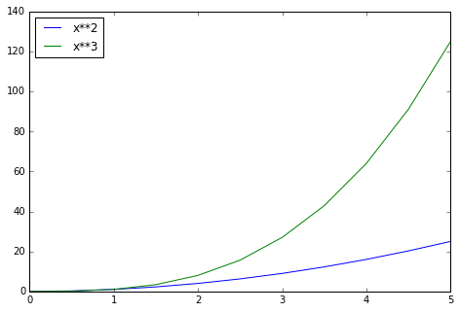
Legends, labels and titles

Slide 24
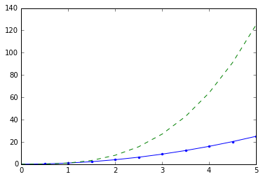
Setting colors, linewidths, linetypes
fig, ax = plt.subplots()
ax.plot(x, x**2, 'b.-') # blue line with dots
ax.plot(x, x**3, 'g--') # green dashed line

Slide 25
Colors with the color= parameter
fig, ax = plt.subplots()
ax.plot(x, x+1, color="blue", alpha=0.5) # half-transparant
ax.plot(x, x+2, color="#8B008B") # RGB hex code
ax.plot(x, x+3, color="#FF8C00") # RGB hex code
ax.plot(x, x+1, color="red", linewidth=0.25)
possible linestype options ‘-‘, ‘–’, ‘-.’, ‘:’, ‘steps’
ax.plot(x, x+5, color="green", lw=3, linestyle='-')
# possible marker symbols: marker = '+', 'o', '*', 's', ',', '.', '1', '2', '3', '4', ...
ax.plot(x, x+ 9, color="blue", lw=3, ls='-', marker='+')

Slide 26
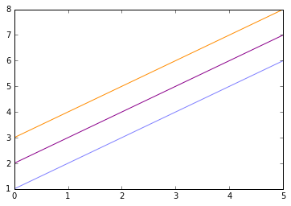
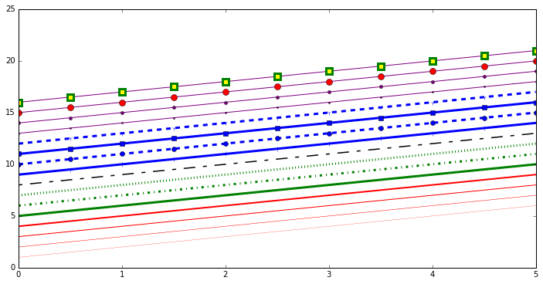
Colors with the color= parameter

Slide 27
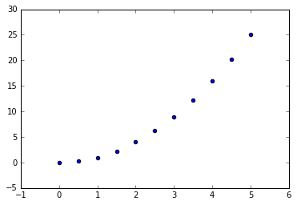
Special Plot Types-Scatter Plot
plt.scatter(x,y)

Slide 28
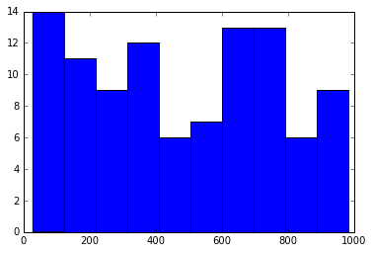
Special Plot Types-Histogram Plot
from random import sample
data = sample(range(1, 1000), 100)
plt.hist(data)

Slide 29
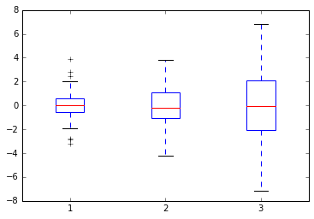
Special Plot Types-Box Plot
data = [np.random.normal(0, std, 100) for std in range(1, 4)]
# rectangular box plot
plt.boxplot(data,vert=True,patch_artist=True);

Slide 30
Other Plots
fig, axes = plt.subplots(1, 4, figsize=(12,3))
axes[0].scatter(xx, xx + 0.25*np.random.randn(len(xx)))
axes[0].set_title("scatter")
axes[1].step(n, n**2, lw=2)
axes[1].set_title("step")
axes[2].bar(n, n**2, align="center", width=0.5, alpha=0.5)
axes[2].set_title("bar")
axes[3].fill_between(x, x**2, x**3, color="green", alpha=0.5);
axes[3].set_title("fill_between");

Slide 31
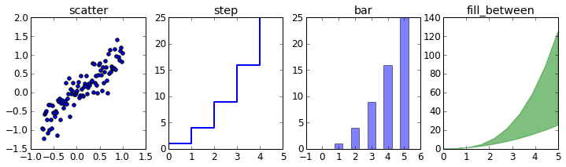
Other Plots

Slide 32
Selecting the Right Chart
Which chart is best suited?
How many variables to show in a single chart? One, two, three, many?
How many items (data points) will you display for each variable? Only a few or many?
Will you display values over a period of time, or among items or groups?

Slide 33
